Slide 1
Chapter 2 – Divide-and-conquer Algorithms
Parth Nagarkar
* Content borrowed from: S. Dasgupta, C. H. Papadimitriou, and U. V. Vazirani. Algorithms

Slide 2
What is the D-a-C strategy?
Divide-and-Conquer Strategy solves a problem by:
Breaking it into subproblems that are themselves smaller instances of the same type of problem
Recursively solving these subproblems
Appropriately combining their answers

Slide 3
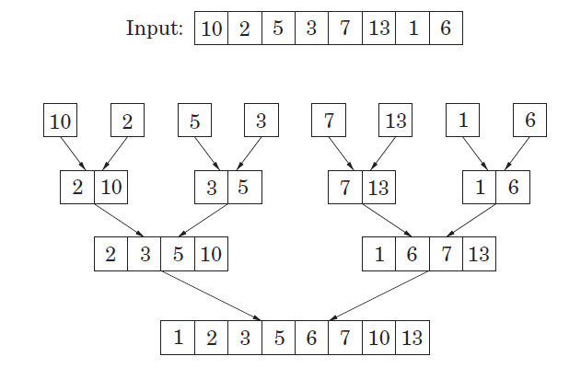
Example: Mergesort

Slide 4
Divide-and-Conquer Strategy
The correctness of a D-a-C algorithm can usually be proven by mathematical induction
The computational cost of D-a-C algorithm can be usually found by solving recurrence relations
D-a-C algorithms can be naturally implemented as recursive procedures

Slide 5
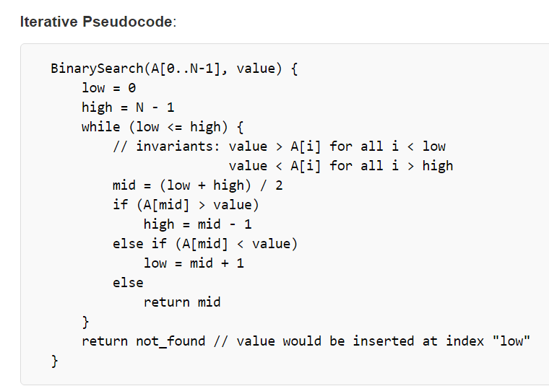
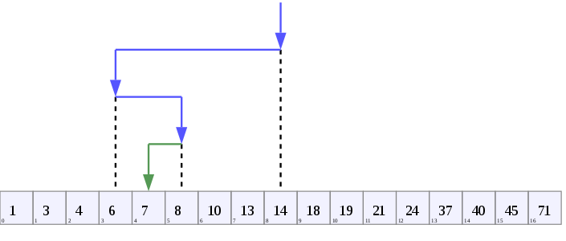
Example: Binary Search
Image borrowed from: https://en.wikipedia.org/wiki/Binary_search_algorithm
Code borrowed from: https://rosettacode.org/wiki/Binary_search

Slide 6
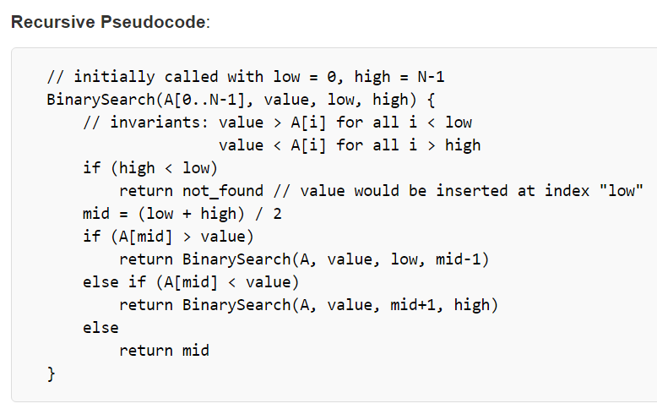
Example: Binary Search
Image borrowed from: https://en.wikipedia.org/wiki/Binary_search_algorithm
Code borrowed from: https://rosettacode.org/wiki/Binary_search

Slide 7
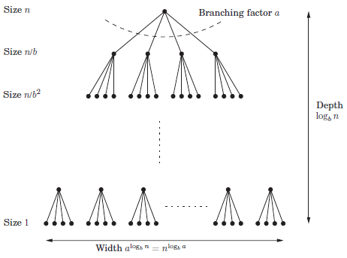
Divide-and-Conquer Strategy

Slide 8
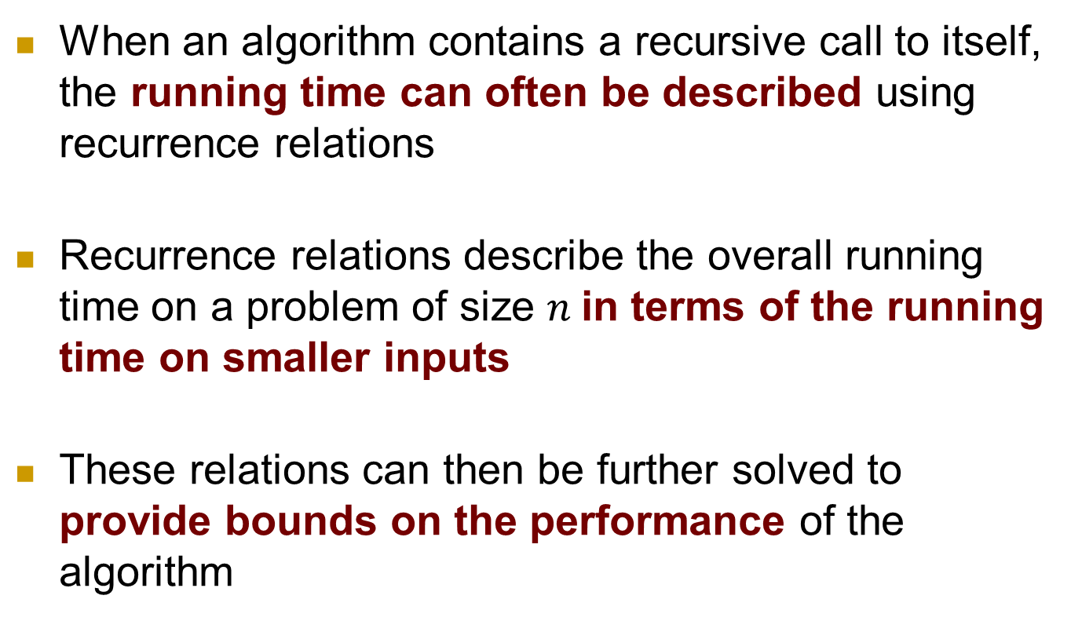
Recurrence Relations
When an algorithm contains a recursive call to itself, the running time can often be described using recurrence relations
Recurrence relations describe the overall running time on a problem of size $n$in terms of the running time on smaller inputs
These relations can then be further solved to provide bounds on the performance of the algorithm

Slide 9
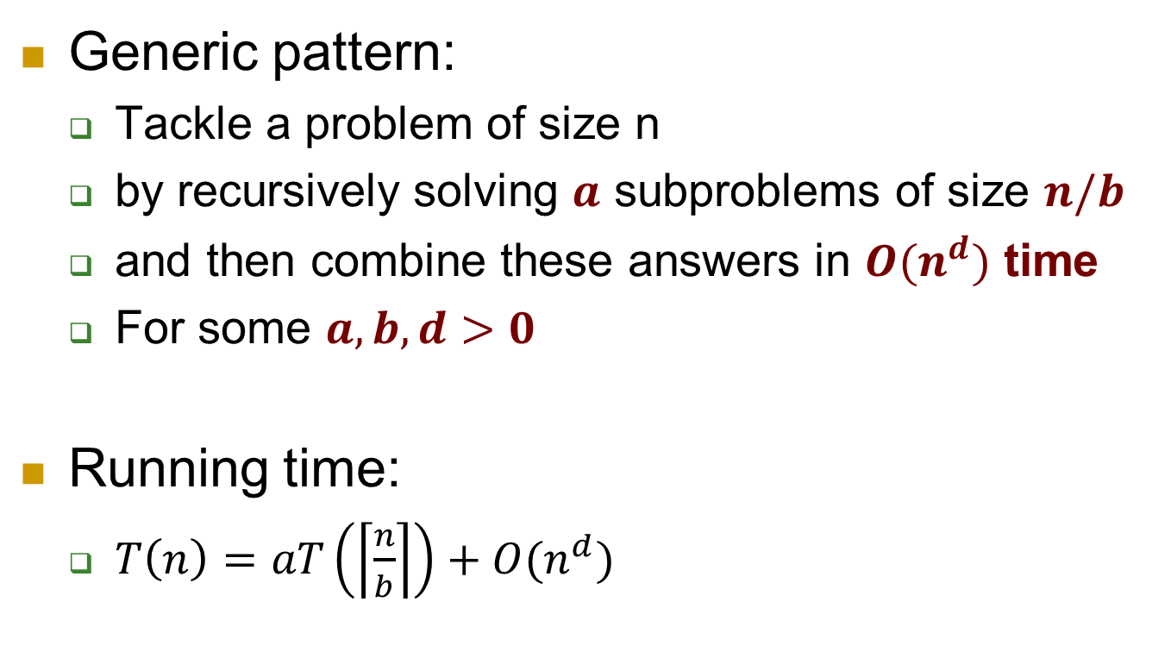
Recurrence Relations
Generic pattern:
Tackle a problem of size n
by recursively solving $a$ subproblems of size $n/b$
and then combine these answers in $O(n^{d})$ time
For some $a,b,d>0$
Running time:
$T\left(n\right)=aT\left(\left\lceil \frac{n}{b}\right\rceil \right)+O(n^{d})$

Slide 10
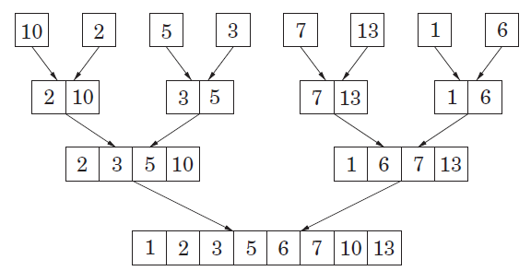
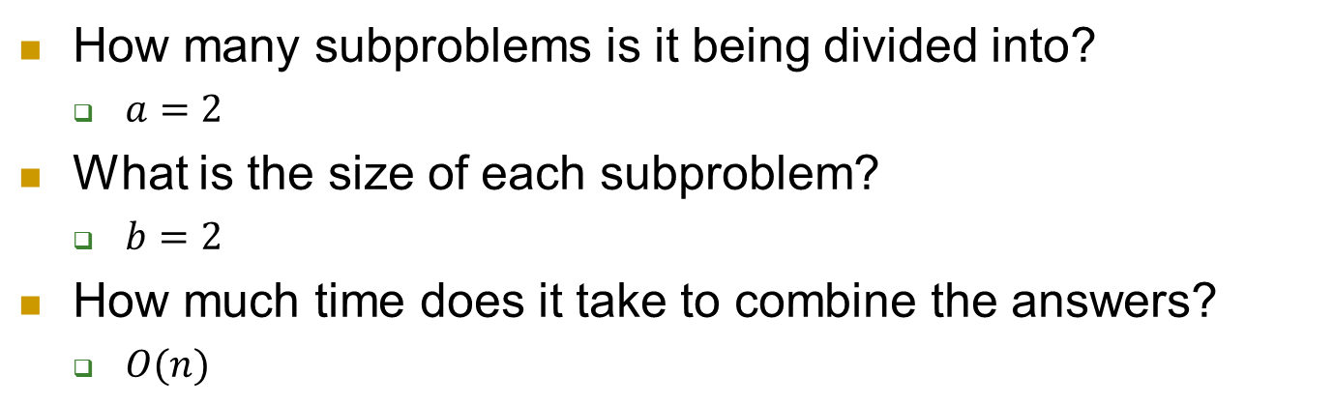
Mergesort
How many subproblems is it being divided into?
$a=2$
What is the size of each subproblem?
$b=2$
How much time does it take to combine the answers?
$O(n)$

Slide 11
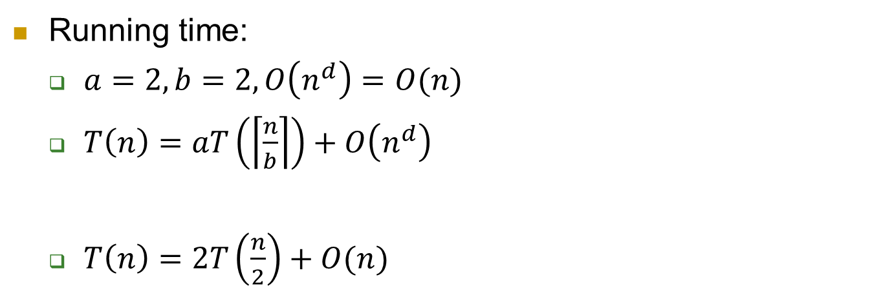
Mergesort
Running time:
$a=2, b=2, O\left(n^{d}\right)=O(n)$
$T\left(n\right)=aT\left(\left\lceil \frac{n}{b}\right\rceil \right)+O\left(n^{d}\right)$
$T\left(n\right)=2T\left(\frac{n}{2}\right)+O(n)$
What about the
ceiling function?
Notes:
Ceiling function, floor function, boundary cases are ignored. They usually do not matter, since as n becomes really large, the time is dominated by n

Slide 12
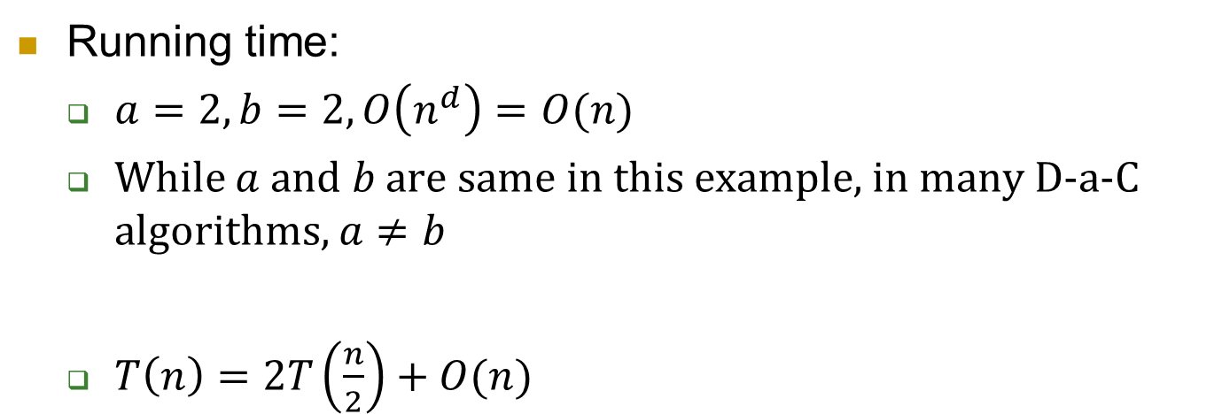
Mergesort
Running time:
$a=2, b=2, O\left(n^{d}\right)=O(n)$
While $a$ and $b$ are same in this example, in many D-a-C algorithms, $a≠b$
$T\left(n\right)=2T\left(\frac{n}{2}\right)+O(n)$

Slide 13
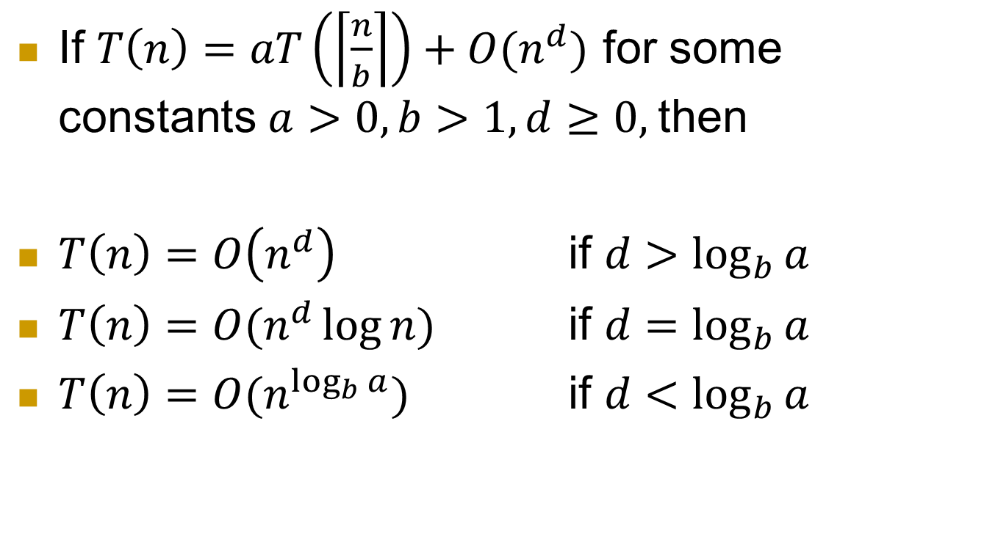
Master Theorem
If $T\left(n\right)=aT\left(\left\lceil \frac{n}{b}\right\rceil \right)+O(n^{d})$ for some constants $a>0, b>1, d≥0,$then
$T\left(n\right)=O\left(n^{d}\right)$ if $d>\log_{b}{a}$
$T\left(n\right)=O(n^{d}\log{n)}$ if $d=\log_{b}{a}$
$T\left(n\right)=O(n^{\log_{b}{a}})$ if $d<\log_{b}{a}$

Slide 14

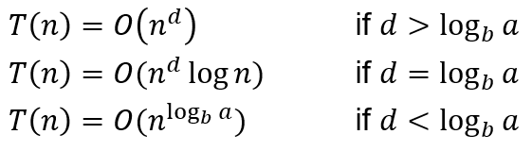
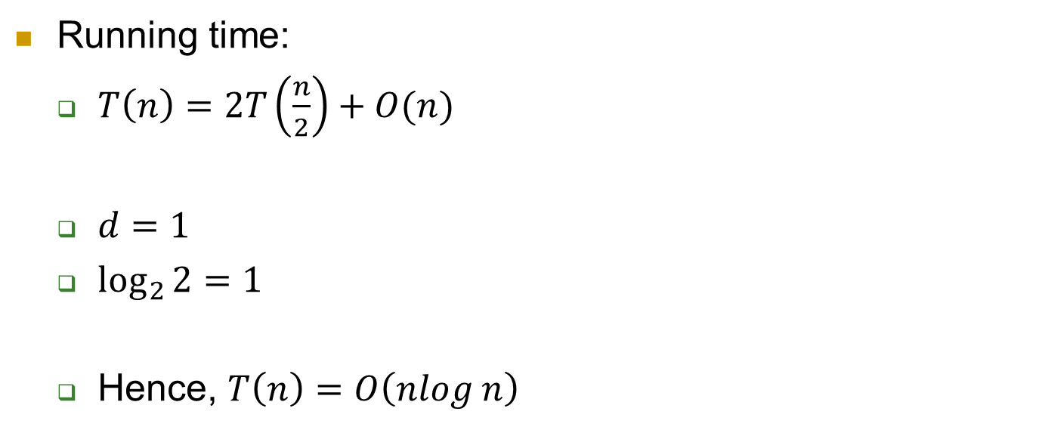
Mergesort
, then
Running time:
$T\left(n\right)=2T\left(\frac{n}{2}\right)+O(n)$
$d=1$
$\log_{2}{2}=1$
Hence, $T\left(n\right)=O\left(nlog n\right)$

Slide 15
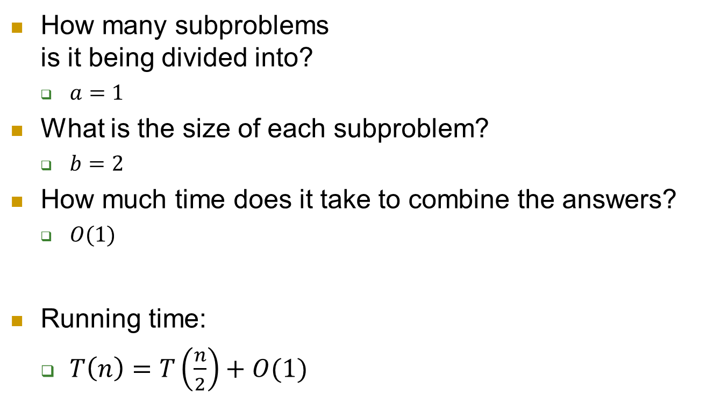
What about binary search?
How many subproblems is it being divided into?
$a=1$
What is the size of each subproblem?
$b=2$
How much time does it take to combine the answers?
$O(1)$
Running time:
$T\left(n\right)=T\left(\frac{n}{2}\right)+O(1)$

Slide 16

Binary Search
, then
Running time:
$T\left(n\right)=T\left(\frac{n}{2}\right)+O(1)$
$d=0$
$\log_{2}{1}=0$
Hence, $T\left(n\right)=O\left(log n\right)$

Slide 17
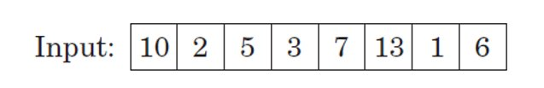
Quicksort
Index
0
1
2
3
4
5
6
7
Array A
Quicksort (A, low, high)
If (low < high)
j = partition (A, low, high)
Quicksort (A, low, j)
Quicksort (A, j + 1, high)
Code borrowed from: https://en.wikipedia.org/wiki/Quicksort

Slide 18
Quicksort
Index
0
1
2
3
4
5
6
7
Array A
Choose a pivot
Correctly position the pivot such that:
Correct position in final, sorted array
Items to the left are smaller
Items to the right are larger
Code borrowed from: https://en.wikipedia.org/wiki/Quicksort

Slide 19
Quicksort
Index
0
1
2
3
4
5
6
7
Choose a pivot (in this case, we will choose the pivot to be the first element, i.e. A[low], in the given array)
While i<j
Increment i until you find an element greater than pivot
Decrement j until you find an element smaller than pivot
If (i<j)
then swap (A[i], A[j])
swap (A[low], A[j])
return j
The above pseudocode changes based on how the pivot was chosen
Notes:
Use this approach for lab 2

Slide 20
Quicksort
How does Quicksort run on this array?
Choose the middle index as the pivot
1 | 3 | 6 | 8 | 9 | 10 | 12 | 13
What is the complexity for this scenario?
Analyze with and without using recurrence relations
Notes:
Best case scenario: O(nlogn)

Slide 21
Quicksort
How does Quicksort run on this array?
Choose the lowest index as the pivot
1 | 3 | 6 | 8 | 9 | 10 | 12 | 13
What is the complexity for this scenario?
First, let’s analyze it without using recurrence relations
Notes:
Worst case scenario: O(n^2)

Slide 22
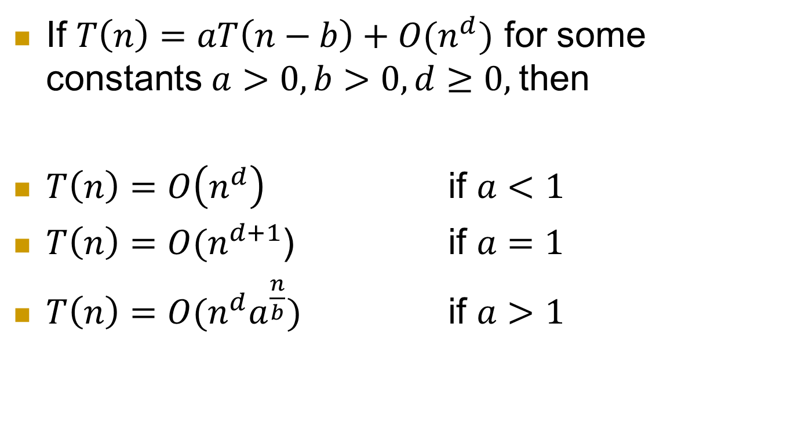
Master Theorem for Decrease-and-Conquer Functions
If $T\left(n\right)=aT\left(n−b\right)+O(n^{d})$ for some constants $a>0, b>0, d≥0,$then
$T\left(n\right)=O\left(n^{d}\right)$ if $a<1$
$T\left(n\right)=O(n^{d+1}$) if $a=1$
$T\left(n\right)=O(n^{d}a^{\frac{n}{b}})$ if $a>1$

Slide 23
Quicksort
How does Quicksort run on this array?
Choose the lowest index as the pivot
1 | 3 | 6 | 8 | 9 | 10 | 12 | 13
What is the complexity for this scenario?
Now, analyze it using recurrence relations
Notes:
Worst case scenario: O(n^2)

Slide 24
Quicksort
How do you choose the pivot?
Choose the median element of the array
What is the drawback of this approach?
Choose a random element of the array
“Many people regard the resulting randomized version of quicksort as the sorting algorithm of choice for large enough inputs.”
Because we randomly choose the pivot element, we expect the split of the input array to be reasonably well balanced on average
Notes:
Quote from CLRS textbook

Slide 25
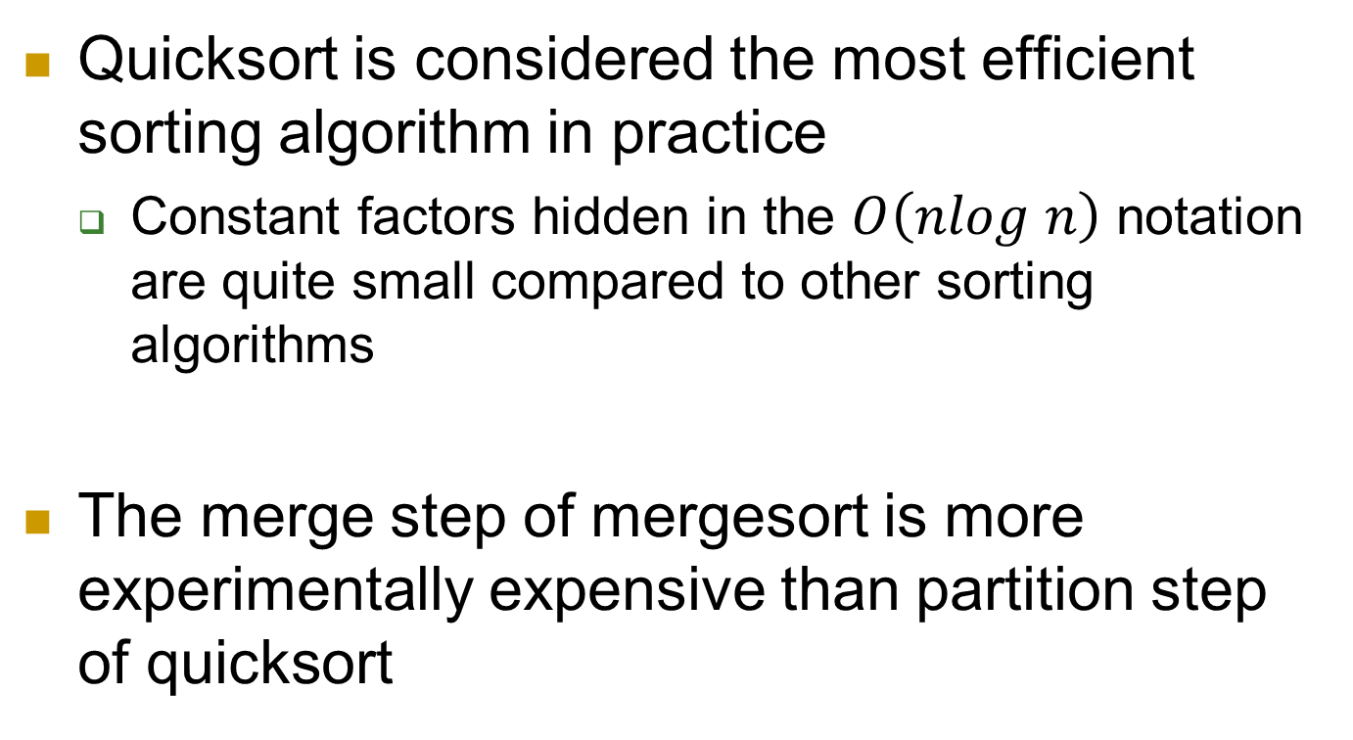
Sorting algorithms
Quicksort is considered the most efficient sorting algorithm in practice
Constant factors hidden in the $O\left(nlog n\right)$ notation are quite small compared to other sorting algorithms
The merge step of mergesort is more experimentally expensive than partition step of quicksort

Slide 26
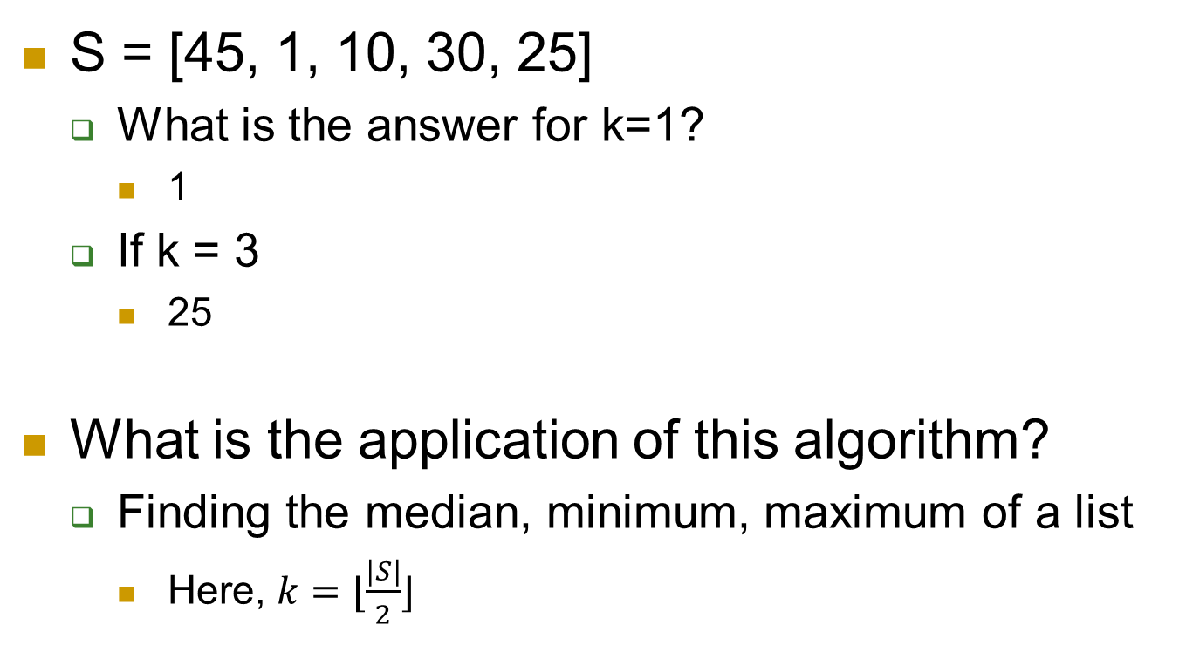
Finding the kth smallest element from a given list
S = [45, 1, 10, 30, 25]
What is the answer for k=1?
1
If k = 3
25
What is the application of this algorithm?
Finding the median, minimum, maximum of a list
Here, $k=⌊\frac{\left|S\right|}{2}⌋$

Slide 27
Finding the kth smallest element from a given list
List = [45, 1, 10, 30, 25]
What is the naïve way to do this?
Sort the list, and return the kth element
Drawback of this approach?
We are sorting the list when it is not needed…we only care about the median (not the entire list)

Slide 28

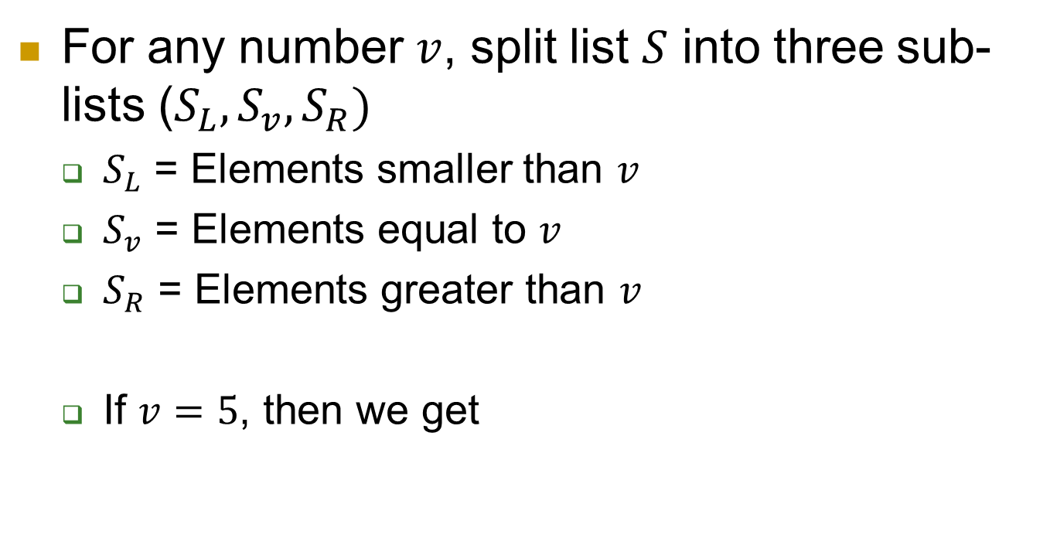
D-a-C algorithm for Selection
For any number $v$, split list $S$ into three sub-lists ($S_{L}, S_{v},S_{R})$
$S_{L}$ = Elements smaller than $v$
$S_{v}$ = Elements equal to $v$
$S_{R}$ = Elements greater than $v$
If $v=5$, then we get

Slide 29
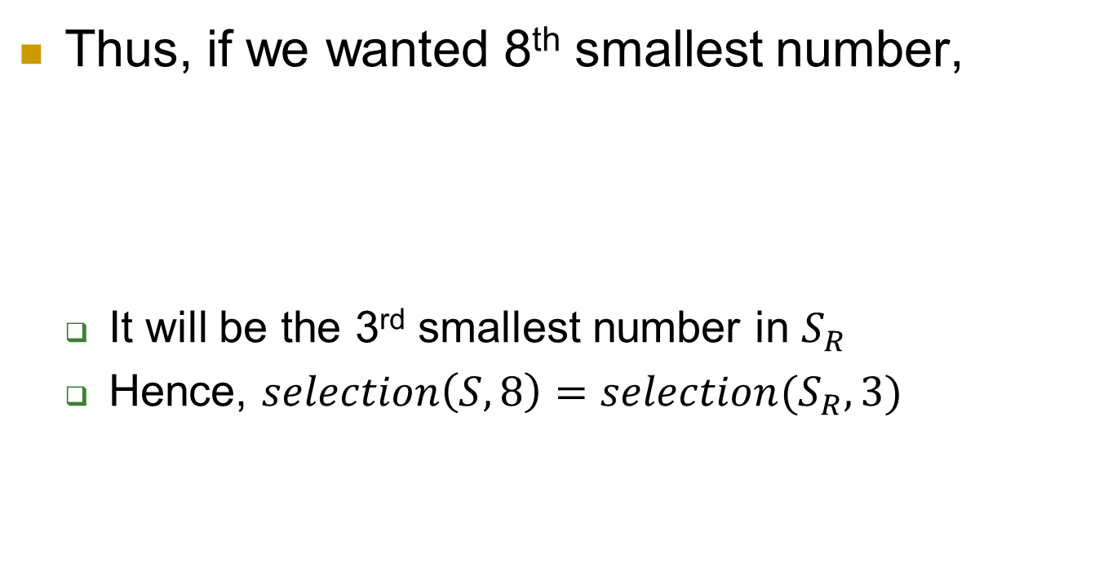
D-a-C algorithm for Selection
Thus, if we wanted 8th smallest number,
It will be the 3rd smallest number in $S_{R}$
Hence, $selection\left(S,8\right)=selection(S_{R},3)$

Slide 30
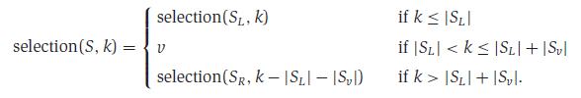
D-a-C algorithm for Selection
Thus, if we wanted 8th smallest number,
Hence, we can quickly determine which sub-list holds the desired element

Slide 31
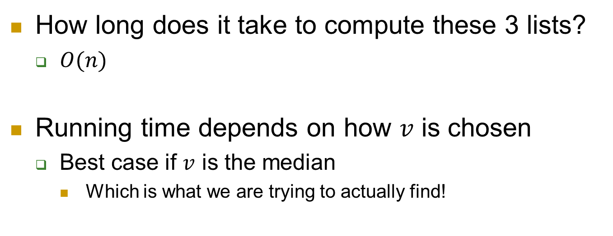
D-a-C algorithm for Selection
How long does it take to compute these 3 lists?
$O(n)$
Running time depends on how $v$ is chosen
Best case if $v$ is the median
Which is what we are trying to actually find!

Slide 32
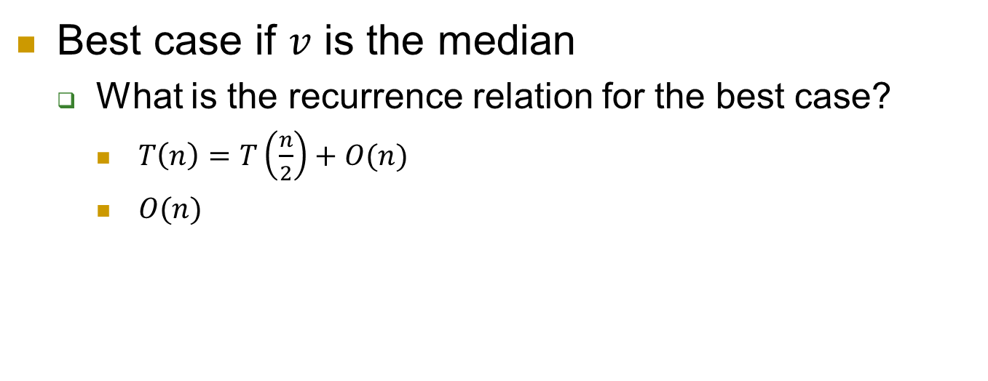
D-a-C algorithm for Selection
Best case if $v$ is the median
What is the recurrence relation for the best case?
$T\left(n\right)=T\left(\frac{n}{2}\right)+O(n)$
$O(n)$

Slide 33
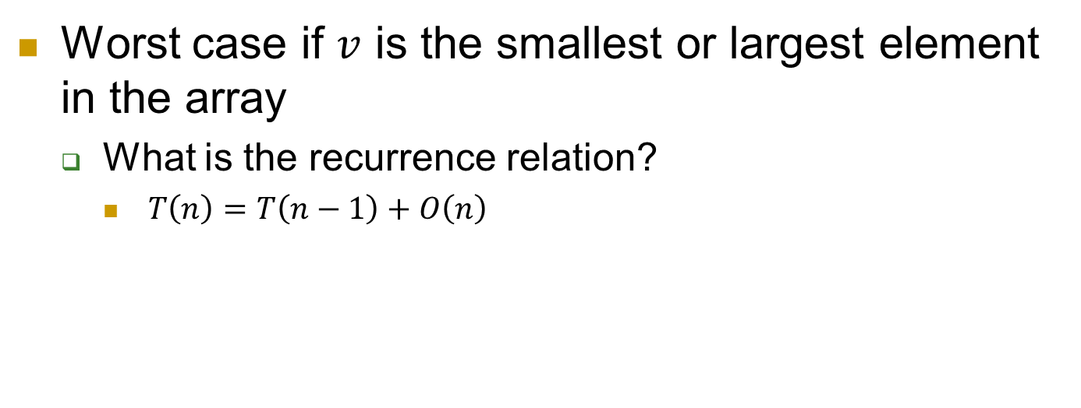
D-a-C algorithm for Selection
Worst case if $v$ is the smallest or largest element in the array
What is the recurrence relation?
$T\left(n\right)=T\left(n−1\right)+O\left(n\right)$

Slide 34
Master Theorem for Decrease-and-Conquer Functions
If $T\left(n\right)=aT\left(n−b\right)+O(n^{d})$ for some constants $a>0, b>0, d≥0,$then
$T\left(n\right)=O\left(n^{d}\right)$ if $a<1$
$T\left(n\right)=O(n^{d+1}$) if $a=1$
$T\left(n\right)=O(n^{d}a^{\frac{n}{b}})$ if $a>1$

Slide 35
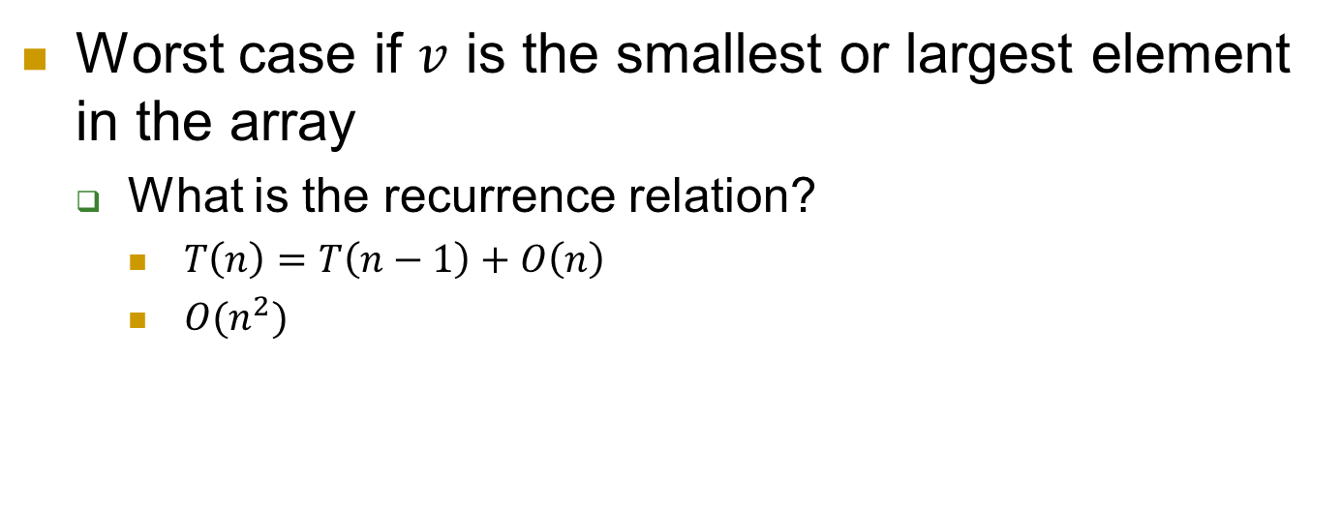
D-a-C algorithm for Selection
Worst case if $v$ is the smallest or largest element in the array
What is the recurrence relation?
$T\left(n\right)=T\left(n−1\right)+O\left(n\right)$
$O(n^{2})$

Slide 36
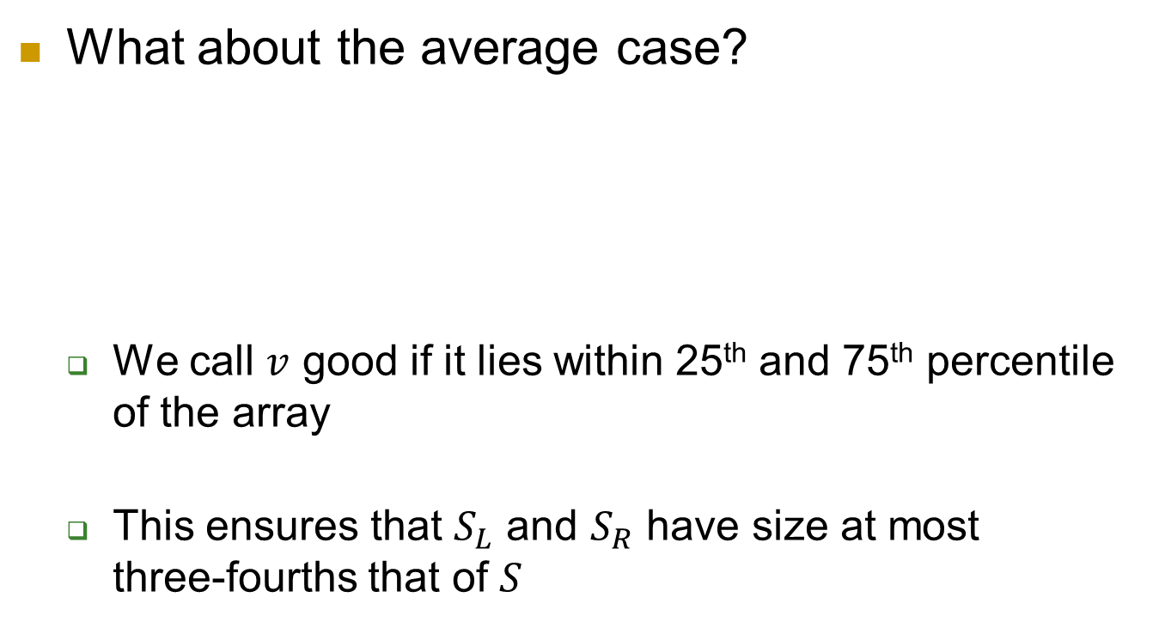
D-a-C algorithm for Selection
What about the average case?
We call $v$ good if it lies within 25th and 75th percentile of the array
This ensures that $S_{L}$ and $S_{R}$ have size at most three-fourths that of $S$
X
X
X
Lowest
value
Median
value
Highest
value

Slide 37
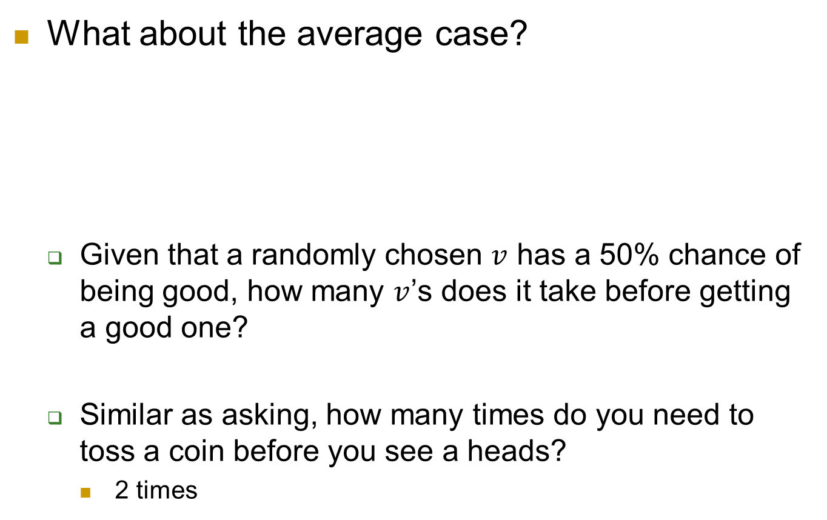
D-a-C algorithm for Selection
What about the average case?
Given that a randomly chosen $v$ has a 50% chance of being good, how many $v$’s does it take before getting a good one?
Similar as asking, how many times do you need to toss a coin before you see a heads?
2 times
X
X
X
Lowest
value
Median
value
Highest
value

Slide 38
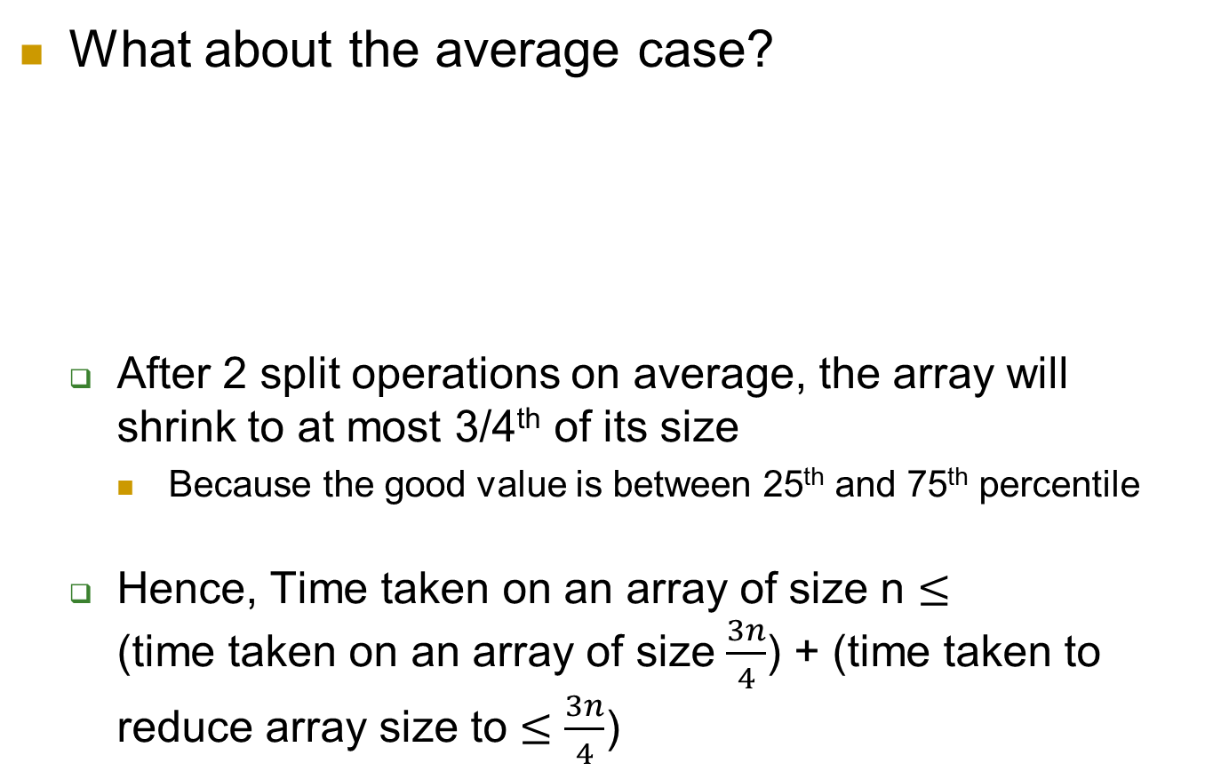
D-a-C algorithm for Selection
What about the average case?
After 2 split operations on average, the array will shrink to at most 3/4th of its size
Because the good value is between 25th and 75th percentile
Hence, Time taken on an array of size n $≤$ (time taken on an array of size $\frac{3n}{4}$) + (time taken to reduce array size to $≤\frac{3n}{4}$)
X
X
X
Lowest
value
Median
value
Highest
value

Slide 39
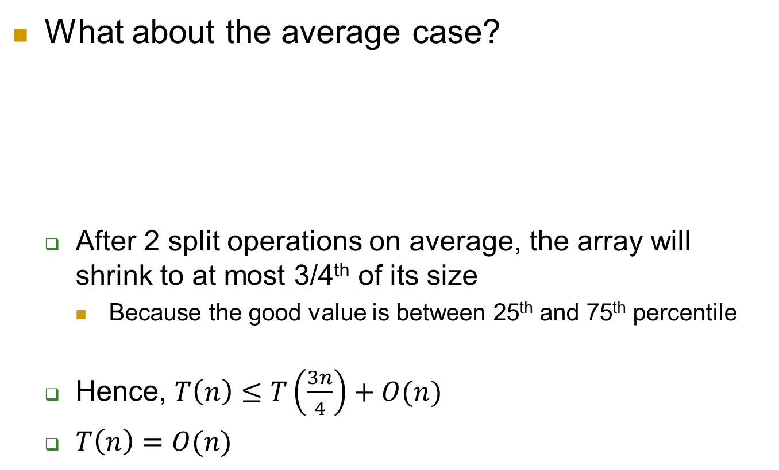
D-a-C algorithm for Selection
What about the average case?
After 2 split operations on average, the array will shrink to at most 3/4th of its size
Because the good value is between 25th and 75th percentile
Hence, $T\left(n\right)≤T\left(\frac{3n}{4}\right)+O(n)$
$T\left(n\right)=O(n)$
X
X
X
Lowest
value
Median
value
Highest
value

